Slide 1
GitHub Repository
Author: Xiao Fu Wu
Date: 15-Feb, 2015

Slide 2
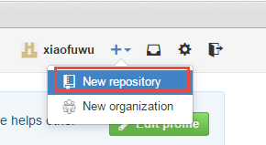
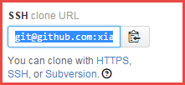
Create a GitHub Account
Open https://github.com/
Register a new yourself account (mine: xiaofuwu/Test1234!)
Login your account.
Create a new repository (public repo, need fee if you want to create private repository)
After create the repository. Can access it by below 3 kinds of way
HTTPS
SSH
Subversion
git@github.com:xiaofuwu/HelloWorld.git

Slide 3
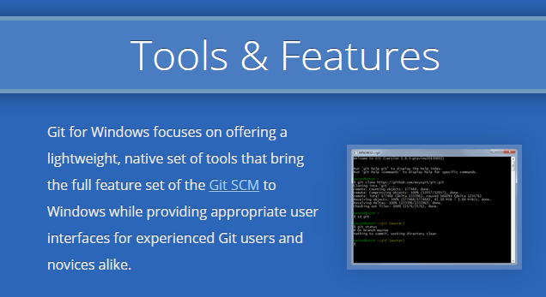
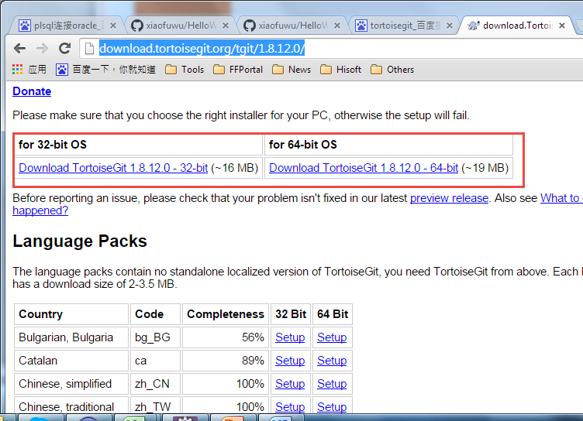
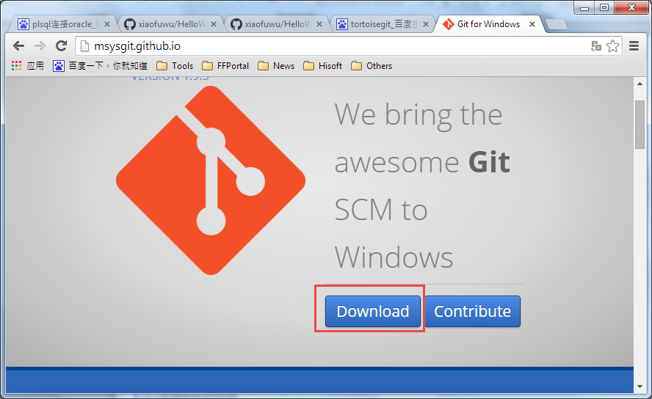
Software installation
Tool | Version | Download Site
TortoiseGit | 1.8.11.0 or above | http://download.tortoisegit.org/tgit/1.8.12.0/
Git for Window | 1.9.4 or above | http://msysgit.github.io/
TortoiseGit: A tool like TortoiseSVN

Slide 4
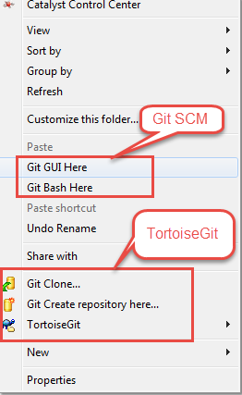
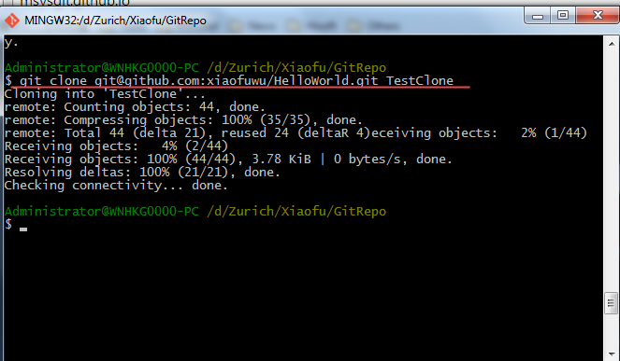
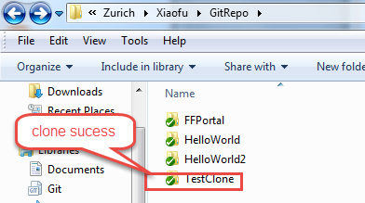
Git GUI and Git Bash
After install Git for window, will see below 2 items in context menu
Git BASH
Git for Windows provides a BASH emulation used to run Git from the command line. *NIX users should feel right at home, as the BASH emulation behaves just like the "git" command in LINUX and UNIX environments.

Slide 5
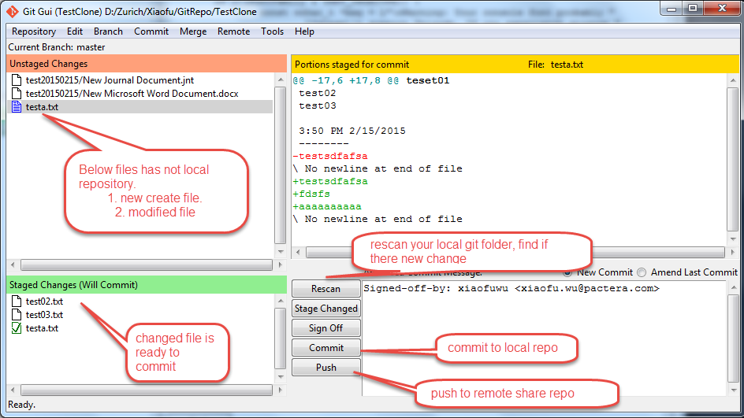
Git GUI and Git Bash
Git GUI
As Windows users commonly expect graphical user interfaces, Git for Windows also provides the Git GUI, a powerful alternative to Git BASH, offering a graphical version of just about every Git command line function, as well as comprehensive visual diff tools.

Slide 6
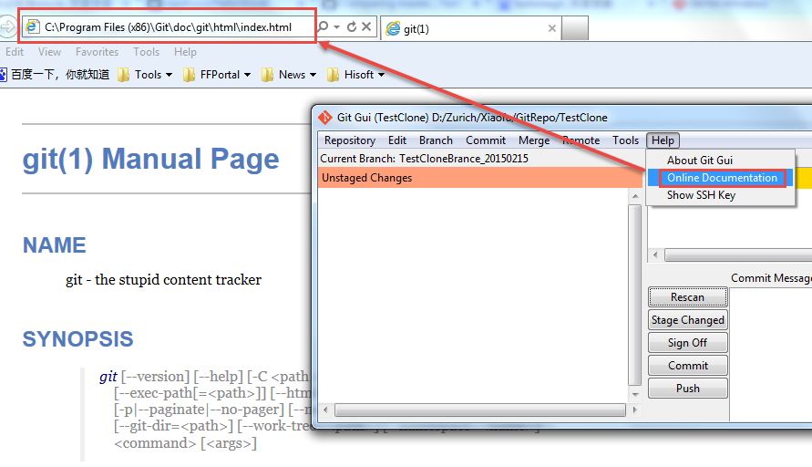
Git GUI and Git Bash
Git online document
From the help document, we can get most of command of Git and know how to use it.
git [--version] [--help] [-C <path>] [-c <name>=<value>] [--exec-path[=<path>]] [--html-path]
[--man-path] [--info-path] [-p|--paginate|--no-pager] [--no-replace-objects] [--bare]
[--git-dir=<path>] [--work-tree=<path>] [--namespace=<name>] <command> [<args>]

Slide 7
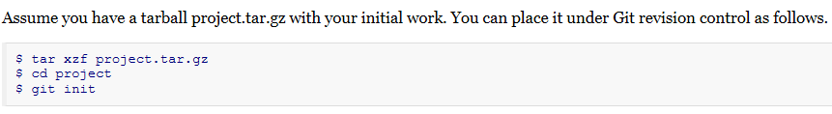
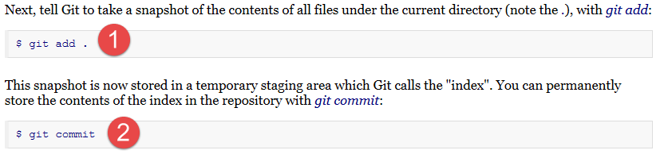
Git tutorial
DESCRIPTION
It is a good idea to introduce yourself to Git with your name and public email address before doing any operation. The easiest way to do so is:
$ git config --global user.name "Your Name Comes Here"
$ git config --global user.email you@yourdomain.example.com
Importing a new project

Slide 8
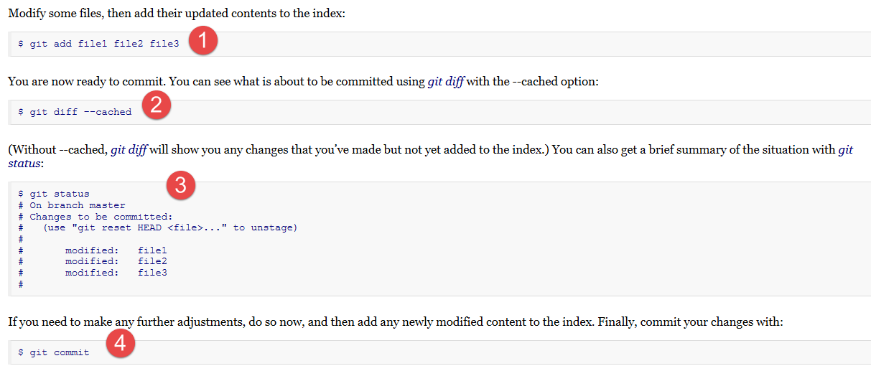
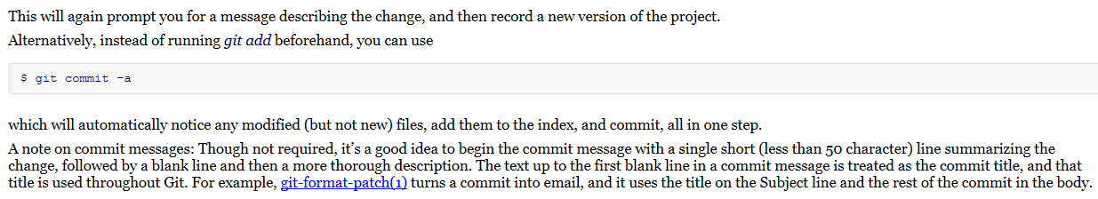
Git tutorial
Making changes

Slide 9
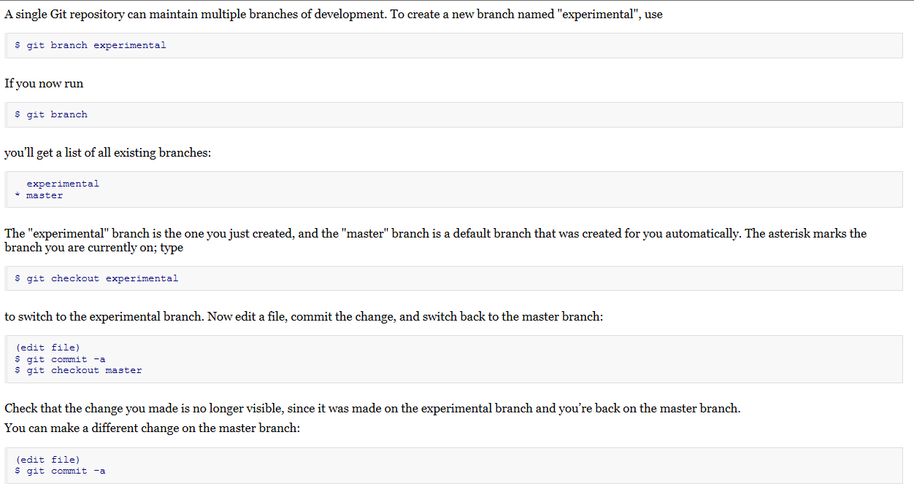
Git tutorial
Managing branches

Slide 10
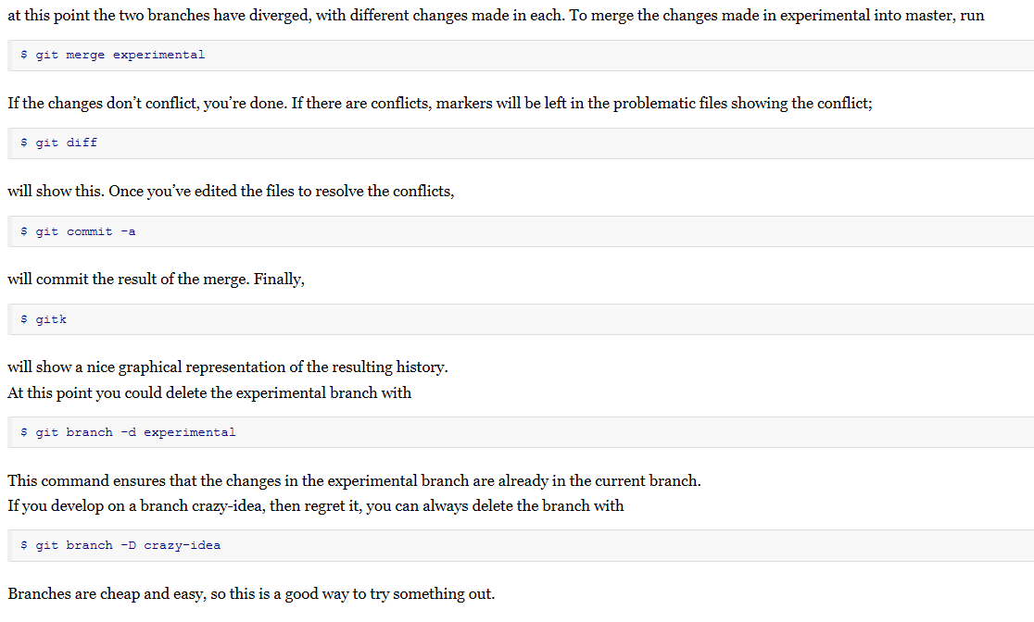
Git tutorial

